Slide 1
Hospital mortality measures
SHMI, HSMR and RAMI compared
CHKS User Group 12 Sept 2018
Chris Raspin

Slide 2
Summary
Context: Why measure hospital mortality
Risk adjustment: What should be taken into account?
Common limitations
Models compared – inputs
Models compared – methods
  Dealing with coding drift (and earthquakes)
Models compared – outputs
Key messages

Slide 3

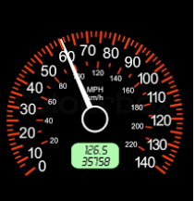
Why do we measure hospital mortality
Because we can
  Deaths are easy to count
Because it can detect poor care (if sufficiently extreme)
  Mid Staffs
Because CQC do
  Speedometers and speed cameras

Slide 4
Risk adjustment: Because patients are not all equal
Age, Sex, Admission type, Diagnosis (inc secondary) are all well evidenced significant factors
Anything else?
  ‘reliable/consistent’ (accurate) data only
  ‘significant’ only (evidence-based)
  attributes ‘beyond control of hospital’ only
  ‘on admission’ factors only
  all of above (aside: would that be AND or OR ?)
  chuck it all in and let the stats package decide

Slide 5

Common limitations
Severity - the missing elephant
Stochastic error - the inconvenient truth
Coding sensitivity – blessing and curse

Slide 6
Models compared: Inputs
SHMI
(deaths after discharge)
Age
Sex
Admission type
Diagnosis
Comorbidity
Year
Length of Stay
Deprivation
Palliative care
Previous admissions
Admission source
Month
RAMI
HSMR

Slide 7
Models compared: Methods
 | HSMR | SHMI | RAMI
Included % inpatient deaths | 83% (main CCS groups) | 100% plus 30 day after discharge | 100% (all CCS groups)
Currency | Super spells | Spells | Spells Bed Days
Reference years | 10 | 3 | 5
Coefficient calculation | Logistic regression | Logistic regression | Direct measurement
What 100% means | Forecasted average (current) | Forced average (current) | Actual average (in reference period)

Slide 8
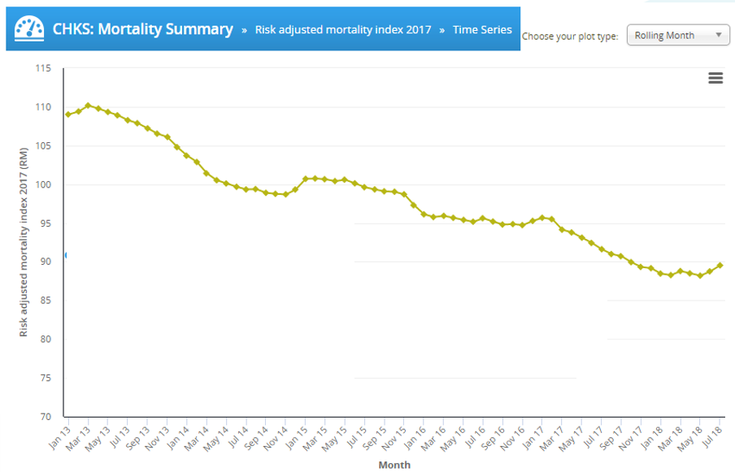
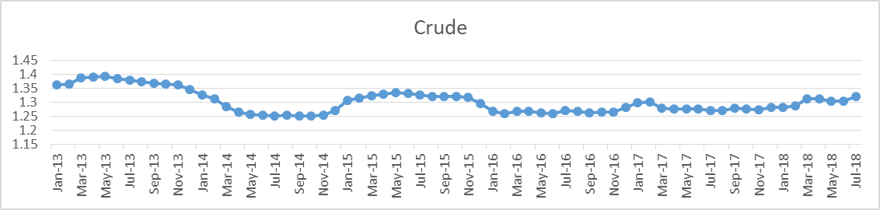
Coding drift
All acute peer average, RAMI
Seismic event
Middle of 5 year reference period

Slide 9
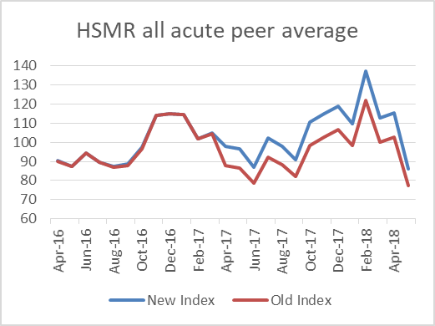
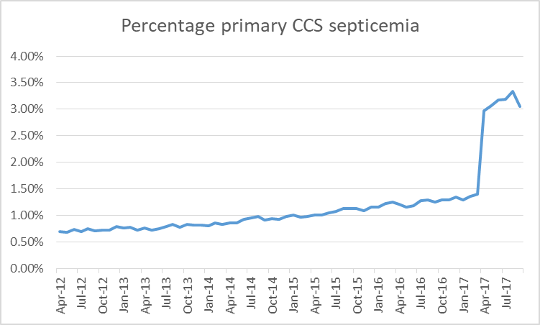
Earthquake in sepsis coding

Slide 10
Dealing with coding drift
Alternative approaches:
Minimise sensitivity to suspect inputs (RAMI)
Project trend into future (HSMR)
Rebase frequently (HSMR annually/quarterly, SHMI quarterly)
As a user:
Don’t assume 100% is the average
Always compare with a well-chosen peer

Slide 11
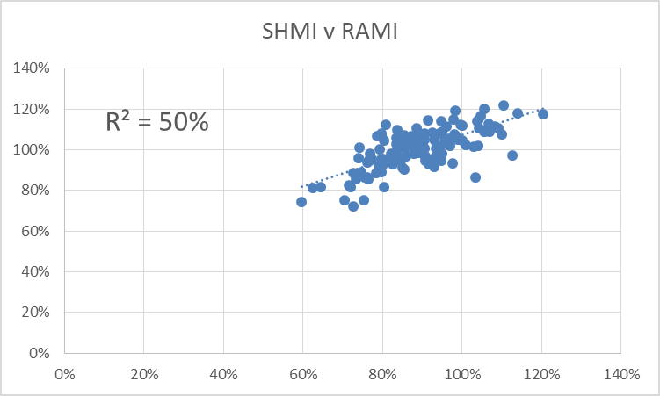
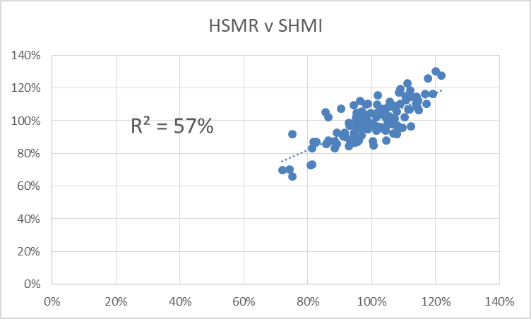
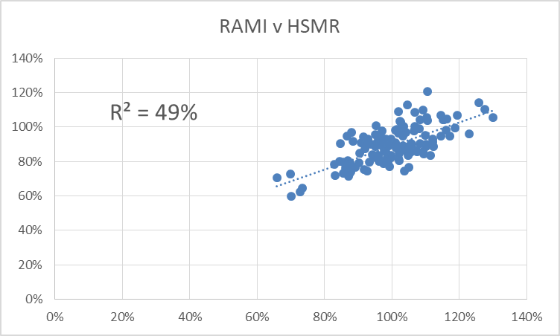
Models compared: Outputs
Period: 2017 calendar year

Slide 12
Key messages
Understand your chosen model’s features and use it appropriately
Severity missing from all models
Always question significance
Always compare with peer not with 100%
All risk models are coding dependent
So always use crude as a check

